Slide 1
Student Counseling Services and the Collegiate Recovery Community

Slide 2
Mental Health Services at a Glance
Individual and Couples Counseling
Gender Transition Services
Substance Use Services
Online and Digital Platforms
Collegiate Recovery Community
Community Referrals
Notes:
Student Counseling Services provides comprehensive mental health support for students. While providing counseling appointments is the number one thing we provide, we also have many other ways that we support students such as through our Collegiate Recovery Community, groups, on-demand mental health apps, workshops and education, and crisis support.

Slide 3
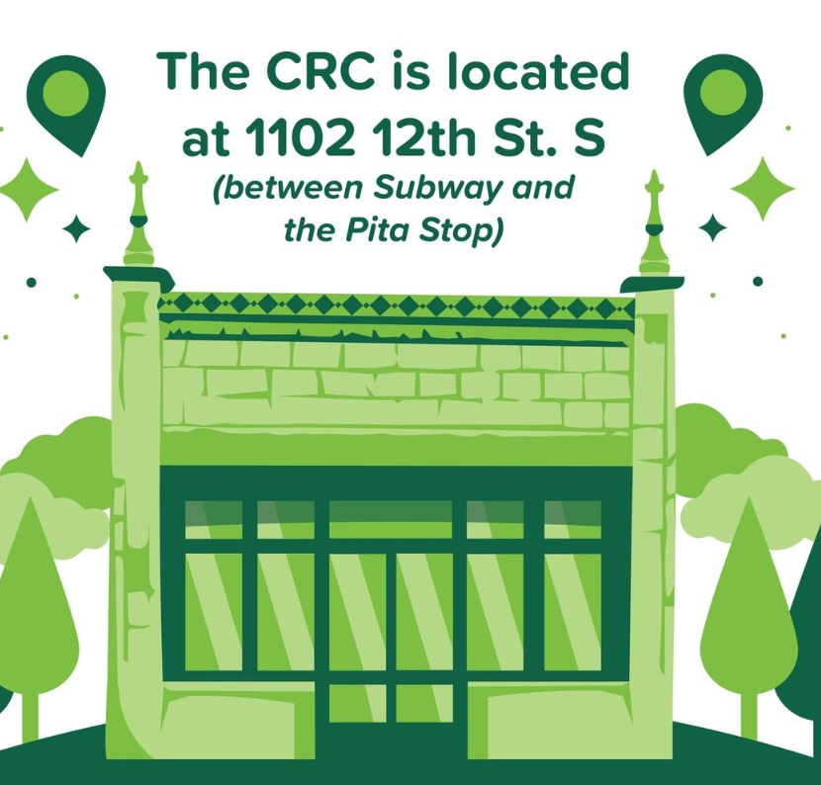

Collegiate Recovery Community
Peer Recovery Meetings
Sober Social Gatherings
Connection with other CRCs in Alabama and regionally
1-1 Check-Ins with professional staff
Student Leadership development
Students attending and presenting at conferences
Notes:
The Collegiate Recovery Community (CRC) is a peer-driven community for UAB students seeking to improve their relationship with substance use. We provide a safe, judgment-free space for students to find support for their substance use concerns, socialize with like-minded peers, and work together to make UAB a more recovery-friendly campus.
We are, above all, a peer community. Students with substance use concerns are much more likely to succeed when they have access to a supportive, welcoming circle of peers who understand the experience of changing one’s relationship to substances while also pursuing a college education. We offer one-on-one conversations with staff, weekly group meetings, outreach opportunities, and social events to connect students in recovery with allies and advocates, as well as other people in recovery from the local community.
What can I expect when I come to the CRC?
We maintain a dedicated space on campus, with resources including a living room for socializing, a conference-style meeting room, and a meditation room for when students need a bit of quiet time. Our student members receive 24/7 access to this space, and we hold open office hours from 10 AM-4 PM on weekdays. All visitors are promised a welcoming, confidential, and zero-judgment environment where they can meet with staff, attend events, study, or just hang out.
Do I have to be in recovery to get involved?
Nope! We welcome everyone with an interest in substance use recovery, including allies and advocates. Our weekly meetings (Tuesdays at 6 PM) are designed to bring these advocates together with students in recovery in the spirit of mutual peer support. We offer a Recovery Ally Training to any group or organization on campus that wants to learn more, and there are plenty of opportunities to volunteer with programming and events.
How do I get in touch?
You can reach our Assistant Director, Kit Emslie, at kpemslie@uab.edu or (205) 996-1612 if you have questions. You can also learn more at uab.edu/recovery or follow us on Instagram: @UABCRC.

Slide 4




Scheduling Appointments
Distance and In-Person Appointments
Monday – Friday, 8am – 5pm
Extended: Residential, Medicine
Confidential, separate records
Free for enrolled students
Web-book appointments through patient portal on website or call
https://www.uab.edu/students/counseling or the UABwell App.
Notes:
Counseling appointments are available for students who are enrolled at UAB. Services are confidential. Students can easily start the counseling process by webbooking their first appointment through their patient portal. They will meet with a counselor who will work with them to identify counseling support and resources to best meet their individual needs.
Our counselors assist with a wide range of concerns:
Depression
Anxiety
Grief
Stress management
Relationships
Family concerns
Adjustment
Anger concerns
Gender identity and sexual orientation
Trauma
Resiliency skills
Coping
And a number of other things!
We are also able to assist students with finding additional care if we are unable to provide the help they need – such as referrals and higher levels of care, or counseling in another state.

Slide 5
Resources to Support Your Mental Health

Slide 6
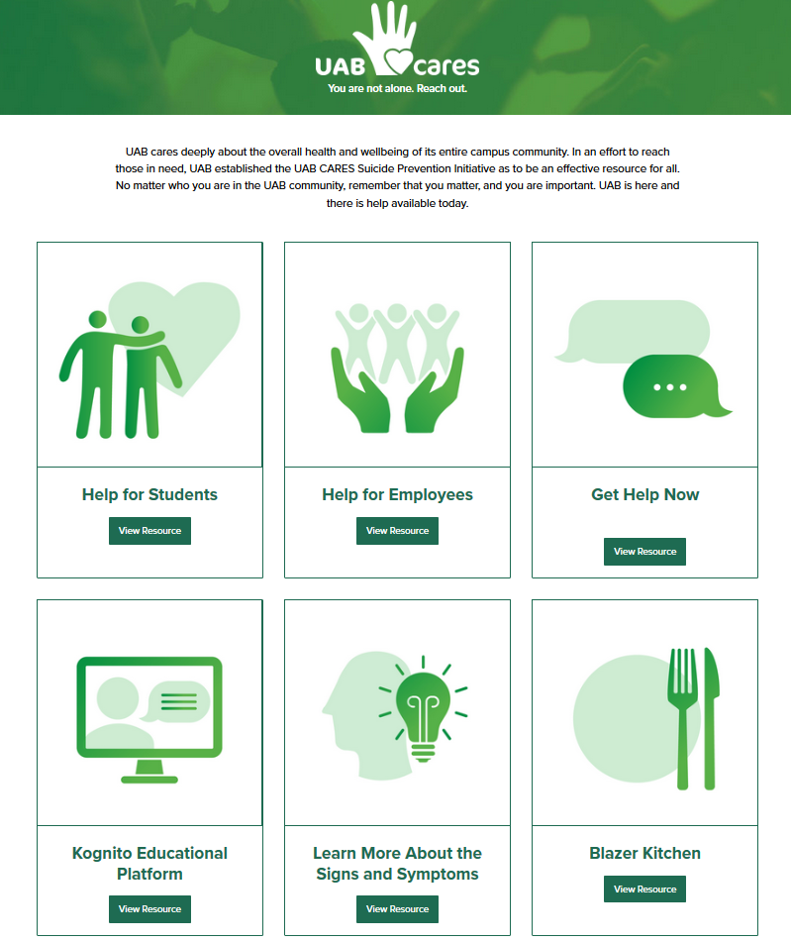
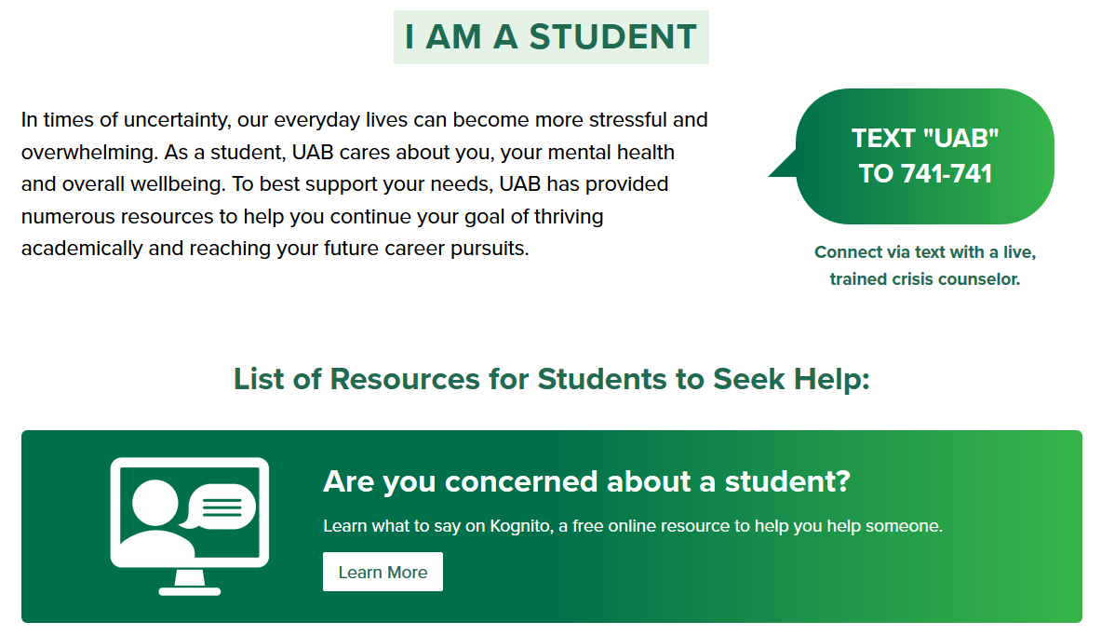
UAB Cares Suicide Prevention https://www.uab.edu/uabcares
Notes:
UAB Cares is our enterprise-wide suicide prevention initiative at UAB. No matter who you are at UAB, if you are part of the UAB community, you are not alone. There is hope for you and support for you. The UAB Cares website is a centralized hub for information about how to get help or help someone who is in crisis and may be considering suicide. There resources for employees and students on this site.

Slide 7


UAB Cares Mental Health Advocate Certificate
Earn up to 3 Levels of Certificates
Showcase your commitment to supporting student mental health
Learn how help someone
Learn UAB mental health resources
Find the Mental Health Advocate Certificate Course in your Canvas Dashboard.
Notes:
The UAB Enterprise Mental Health Advocate Program offers a platform to showcase your commitment to promoting mental health within the UAB community. UAB Mental Health Advocates play a vital role in encouraging others to seek support when needed. And by proudly displaying a Mental Health Advocate Badge, you can inspire others to prioritize well-being in their own lives and contribute to a culture that promotes mental health for all.
As a trained UAB Mental Health Advocate, you will be empowered to…
Promote a culture of mental health awareness.
Identify peers in distress and provide guidance.
Share and recommend mental health resources for the UAB community.
UAB Mental Health Advocates are NOT trained to offer mental health or crisis counseling and coaching.

Slide 8
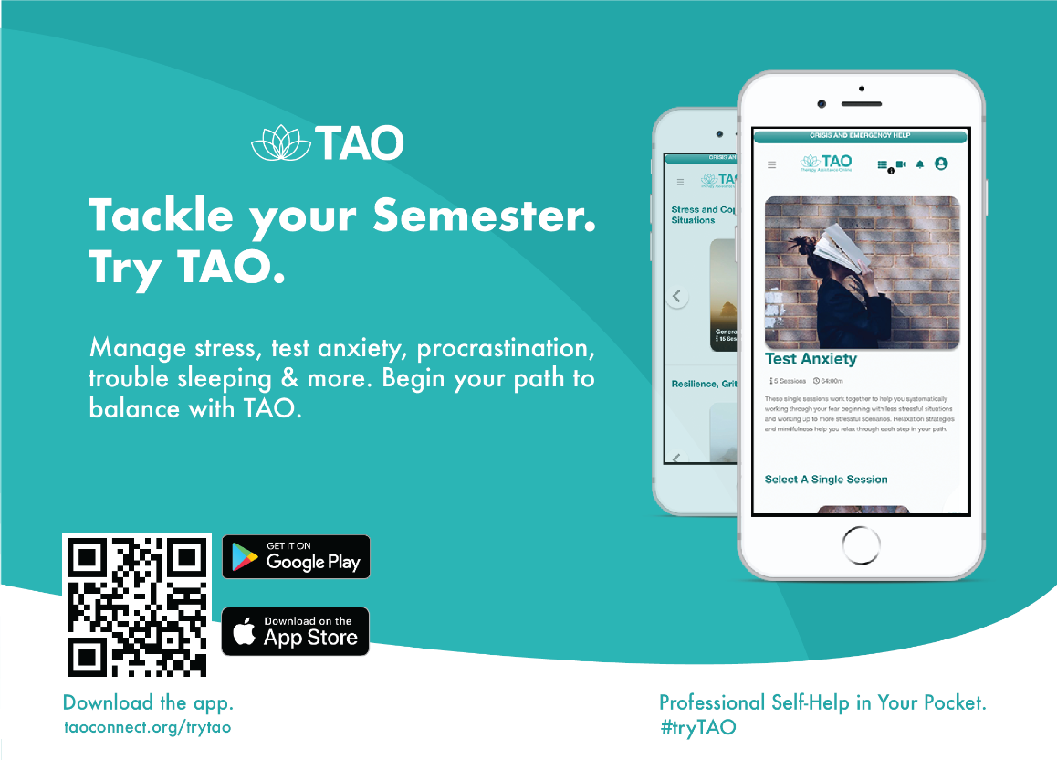
Notes:
Everyone has struggles that sometimes require outside help. Whether you need extra encouragement during a tough time, or you are building your toolkit for better mental health, TAO, Therapy Assistance Online, is here to help!
TAO is a free, self-guided, online platform available to everyone at UAB whether you’re on or off campus. This specialty program provides:
Over 150 brief educational sessions covering up to 50 common mental health topics.
Tips related to mental health, wellness, and substance use issues.
Journal entries and logs to help you process your feelings along with trackers that monitor your progress.
Over 20 mindfulness exercises proven to improve your mood and promote relaxation.
TAO’s scientifically researched self-guided platform can help give you the tools to manage your mental health. Since TAO is available 24/7, you have the option to learn at your own pace. This program can be accessed online and through their downloadable app for Android and iPhone.

Slide 9
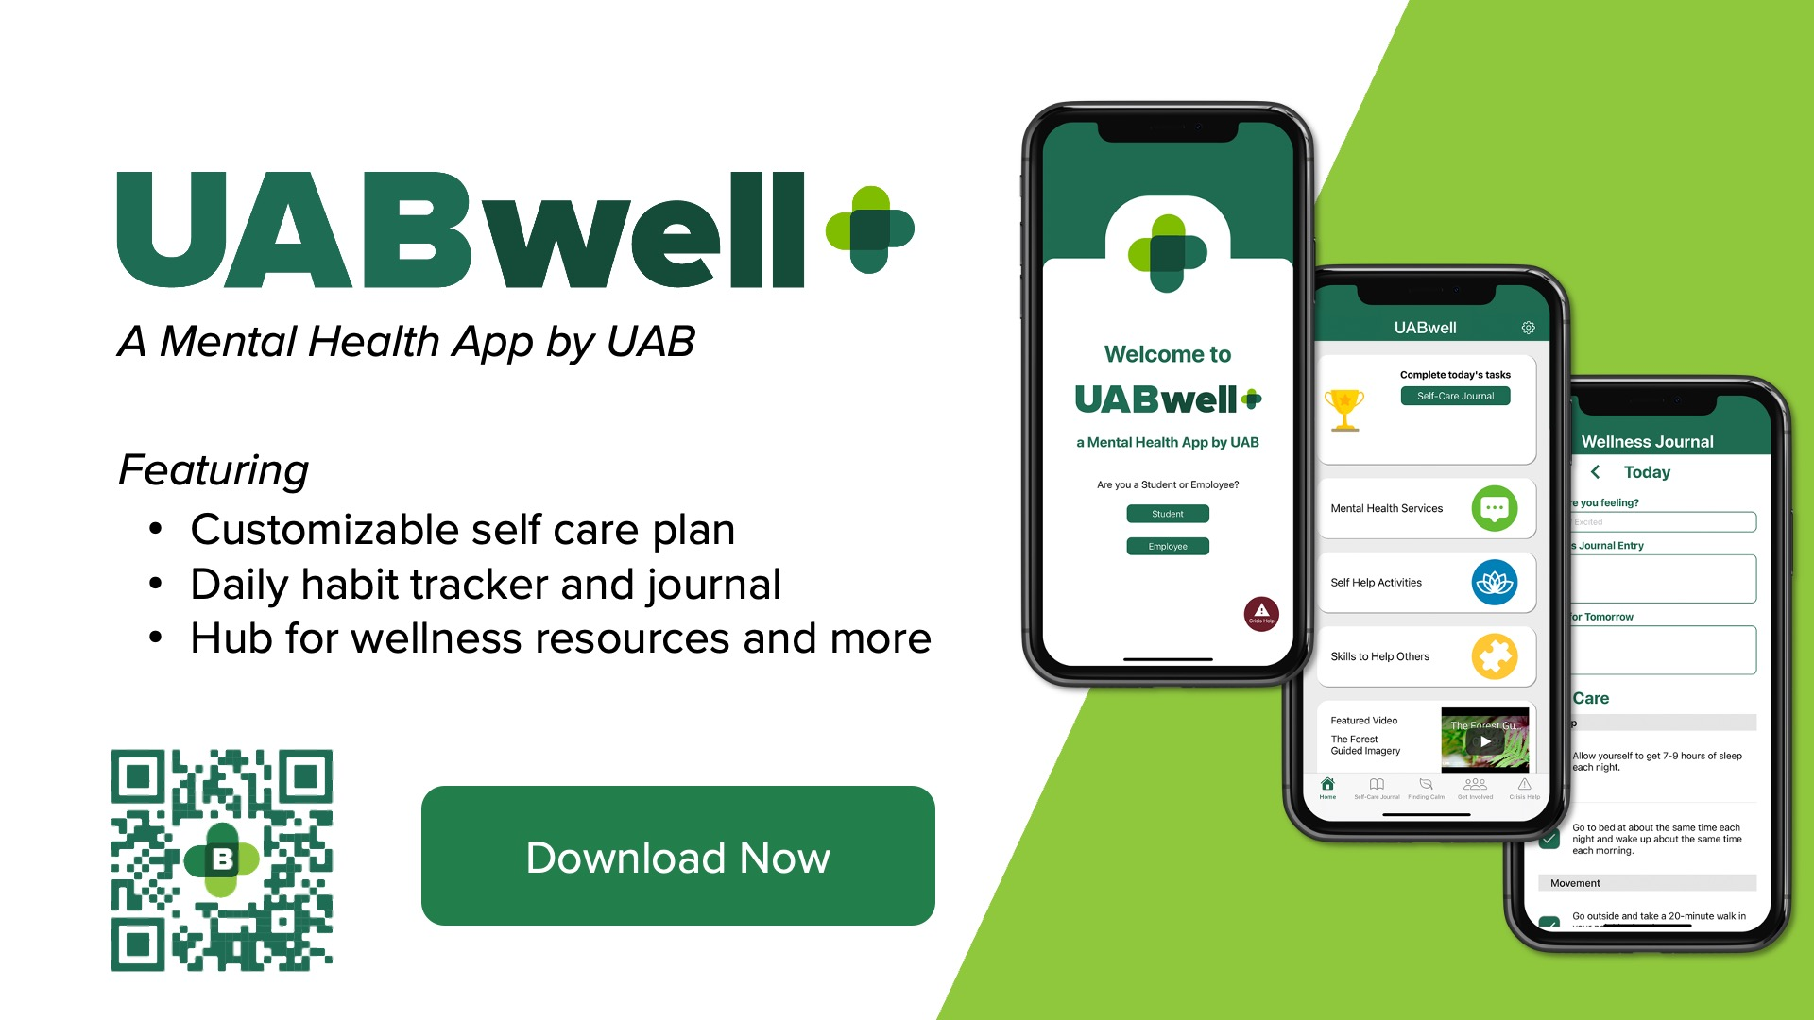
Notes:
Life finds a way of distracting us from the practices that help us feel our best. Sometimes finding the right tools, exercises, or community can be hard. That's why the B Well UAB app is here to help with your mental health journey!
B Well UAB was an app envisioned by students and developed by UAB to provide:
One location contains all of UAB’s mental health resources.
A customizable self-care plan that encourages you to track your progress daily.
The Finding Calm section provides a variety of breathing exercises, yoga videos, mindfulness practices, and more!
An event calendar with up-to-date campus mental health events to keep you plugged in on campus
Notifications that send you inspirational messages throughout the day
Campus resources to support your mental health
Direct access to crisis and emergency mental health support
The app is free and available to UAB students, faculty, and staff!
Download it on the app store for Apple users and Google Play marketplace for androids. With the app’s guidance, you will be connected to mental health resources 24/7.

Slide 10
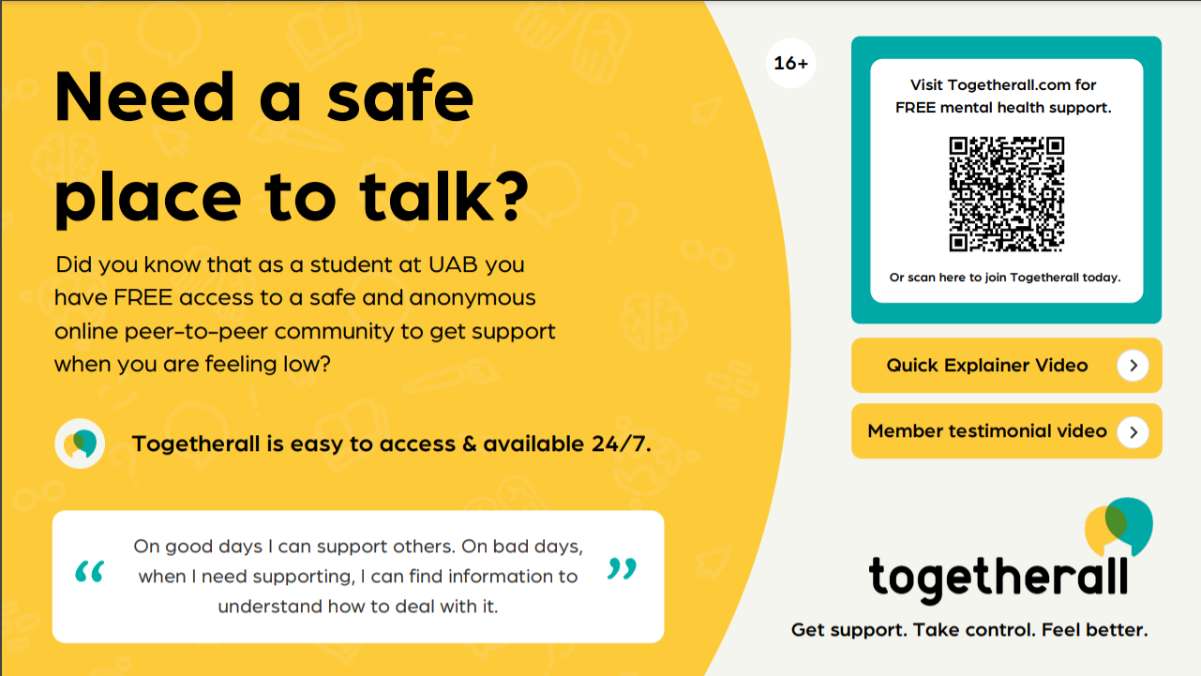
Notes:
Togetherall is an online peer-to-peer platform that offers a safe space for students to:
Share experiences and connect with others by seeking and providing mental health support.
Anonymously talk to peers about how and where you are struggling.
Learn from courses that give you tools to take control of your mental health.
Have access to confidential support from trained professionals.
Togetherall is accessible 24/7, 365 days a year!
Login to create your anonymous username and start sharing your experiences today.
Whether you need support occasionally or find that staying plugged in is helpful, reaching out reminds you that you're not alone. Get support, take control, and start feeling better.

Slide 11



Additional Self Screeners and Self Assessments
Notes:
For students who are interested in learning more about their own mental health concerns or may be concerned about a friend, several of our free platforms offer screening tools to learn more.
eCheck Up to Go
We have online anonymous screeners if you’re curious or concerned about substance use in regards to alcohol or marijuana for you or someone you know. You can participate in this online questionnaire that will provide customized results and recommendations to you based on the information you provide about your use and other behaviors.
Students find it useful to print these out or email themselves a copy that they can bring to a counseling appointment and discuss with a counselor to see if they may need additional support or resources.
U Lifeline Online Screeners and Information
Students can take anonymous online screeners through our website and the ULifeline on-demand program for depression, anxiety, eating disorders, and substance use. While these screeners are not diagnostic, they can provide helpful information to students about whether or not they have concerns that may benefit from counseling or additional support. U Lifeline provides access to helpful information on many mental health topics and concerns.
Students are able to receive customized recommendations and reports are available to help students learn more about their mental health concerns.

Slide 12



Get Involved with Mental Health at UAB
Student Counseling Services
Graduate and undergraduate internships
Notes:
UAB students are actively engaged in promoting mental health awareness, decreasing stigma, and increasing access to mental health support. Several opportunities are available for students to get connected with mental health advocacy on campus.
Mental Health Ambassadors is a peer-to-peer mental health promotion program focused on mental health awareness, resiliency, and self-care. MHAs offer programs and events throughout the year. MHA is a collaboration between Student Counseling Services, The School of Public Health, and the Honors College. The training and application to serve as a MHA is offered each fall, starting in September. See the website for more information.
Active Minds
Active Minds is an organization that utilizes students’ voices to increase awareness about issues surrounding mental health, symptoms related to mental health disorders, and the mental health resources available both on campus and in the surrounding community.
Student Advisory Board for Student Counseling Services
The SCS Student Advisory Council seeks to unite students with the entire UAB community in order to
Bring awareness to student concerns of mental health on campus
Reduce stigma and eliminate barriers to seeking mental health support
Advocate for administration to develop explicit policies in support of mental health services, including training of faculty
Graduate Resilience Outreach and Wellness promotes connectedness, community, and support for graduate students and postdoctoral scholars in order to increase help-seeking, life skills, and resiliency. Signature programs of GROW include MyStory and the monthly de-Stress Power Hour.
AmeriCorps VISTA Service Opportunities
Student Counseling Services and the Collegiate Recovery Program host several AmeriCorps VISTAs each year. VISTAs provide essential capacity-building service to our campus through their education, communication, and outreach efforts to promote mental health, build recovery-ready community on campus, decrease stigma, and connect students to support.
Undergraduate and Graduate Non-Clinical Internships
Each semester, UAB students complete their academic internship opportunities at Student Counseling Services and the Collegiate Recovery Community. Some examples of internship experiences have included creating and managing mental health promotion social media campaigns, conducting research on mental health trends of students, developing programs to raise awareness about mental health services, working on suicide prevention activities, and hosting an Instagram Live series to talk about mental health and UAB students.
Graduate Clinical Counseling Practicum/Internships
Graduate student in masters- or doctoral-level clinical counseling or social work programs may apply for clinical internship placement in Student Counseling Services.

Slide 13

Notes:
Thank you! Please see our website for more information about our services and follow us on Instagram @uabscs and @uabcrc!

