Slide 1
5-10% Hereditary
10-20% Familial
70-80% Sporadic

Slide 2
Sporadic cancer formation
chance
chance
cancer cell
Hereditary cancer formation
chance
cancer cell

Slide 3
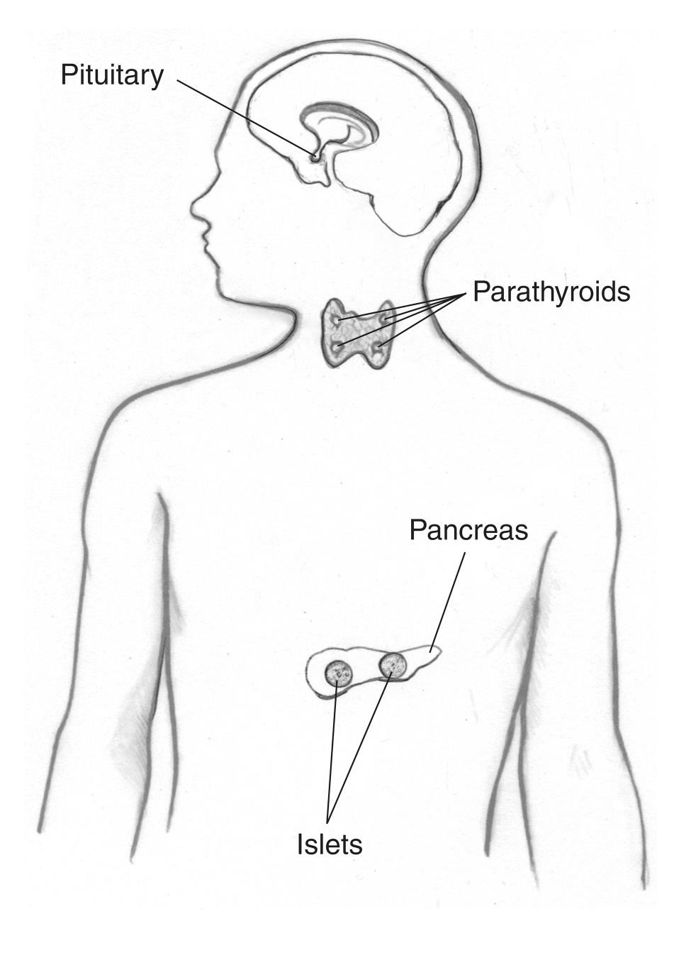
MEN1 Clinical Features
MEN1 Primary Site | Clinical Feature | Likelihood
Parathyroid | Primary hyperparathyroidism, multiglandular dx common | 90% by 20-25yrs 100% by 50yrs
Pituitary | Pituitary adenomas | 15-55%, more common in those AFAB
Pancreas | Well-differentiated endocrine tumors of the Gastroenteropancreatic (GEP) tract | Highest risk for gastrinoma-40%
Adrenocortical | Mostly non-functioning | 40%
Carcinoid | Thymic, bronchial, type II gastric enterochromaffin -like (ECL) | 3-10%
https://www.niddk.nih.gov/health-information/endocrine-diseases/multiple-endocrine-neoplasia-type-1

Slide 4
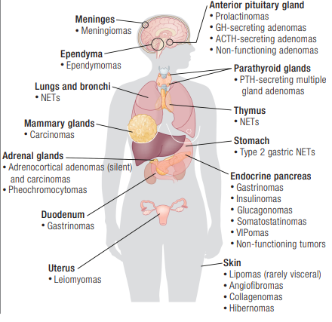
https://www.endocrine.org/journals/endocrine-reviews/men1-latest-insights

Slide 5
MEN1 Clinical Features-Detailed
Tumor Type | Tumor Subtypes | Hormone Secreting | Prevalence in MEN1
Parathyroid | NA | Yes | PHPT in 100% by age 50 yrs
Anterior pituitary | Prolactinoma | Yes | Anterior pituitary tumors in ~30%-40% | 60%
 | GH-secreting | Yes |  | 25%
 | GH/PRL-secreting | Yes |  | 10% ¹
 | TSH-secreting | Yes |  | Rare ²
 | ACTH-secreting | Yes |  | <5% ¹
 | Nonfunctioning | No |  | <10% ¹
Well-differentiated endocrine of the GEP tract | Gastrinoma | Yes | 40%
 | Insulinoma | Yes | 10% ¹
 | Glucagonoma | Yes | <3% ¹
 | VIPoma | Yes | 3%
 | Somatostatinomas | Yes | <1%
 | Nonfunctioning | No | 55% ¹
Carcinoid | Thymic | No | 3%-8% ¹
 | Bronchial | No | 4.7%-6.6% ¹
 | Type II gastric ECL carcinoids | No | 10% ¹
Adrenocortical | Cortisol-secreting | Rarely, hypersecreting | 40% ¹
 | Aldosterone-secreting | Rarely, hypersecreting
 | Pheochromocytoma | Rarely | <1% ¹
https://www.ncbi.nlm.nih.gov/books/NBK1538/#men1.Clinical_Characteristics

Slide 6
MEN1 Screening Guidelines
Begin between 8-15 years old
Tumor Type | Procedure | Frequency
Parathyroid | Calcium (blood test) | Every year
Pancreatic Neuroendocrine Tumors | -Consider abdominal/pelvic CT or MRI with contrast -Consider serial endoscopic ultrasound | Every 1-3 years
Pituitary | -Pituitary or sella MRI with contrast -Prolactin, IGF-1, and other previously abnormal pituitary hormones (blood test) | Every 3-5 years
Lung/Thymic Neuroendocrine Tumors | Consider chest CT or MRI with contrast | Every 1-3 years
Adapted from Neuroendocrine and Adrenal Tumors NCCN Guidelines v 2.2025

