Slide 1
Pre-Test Visual Aids

Slide 2
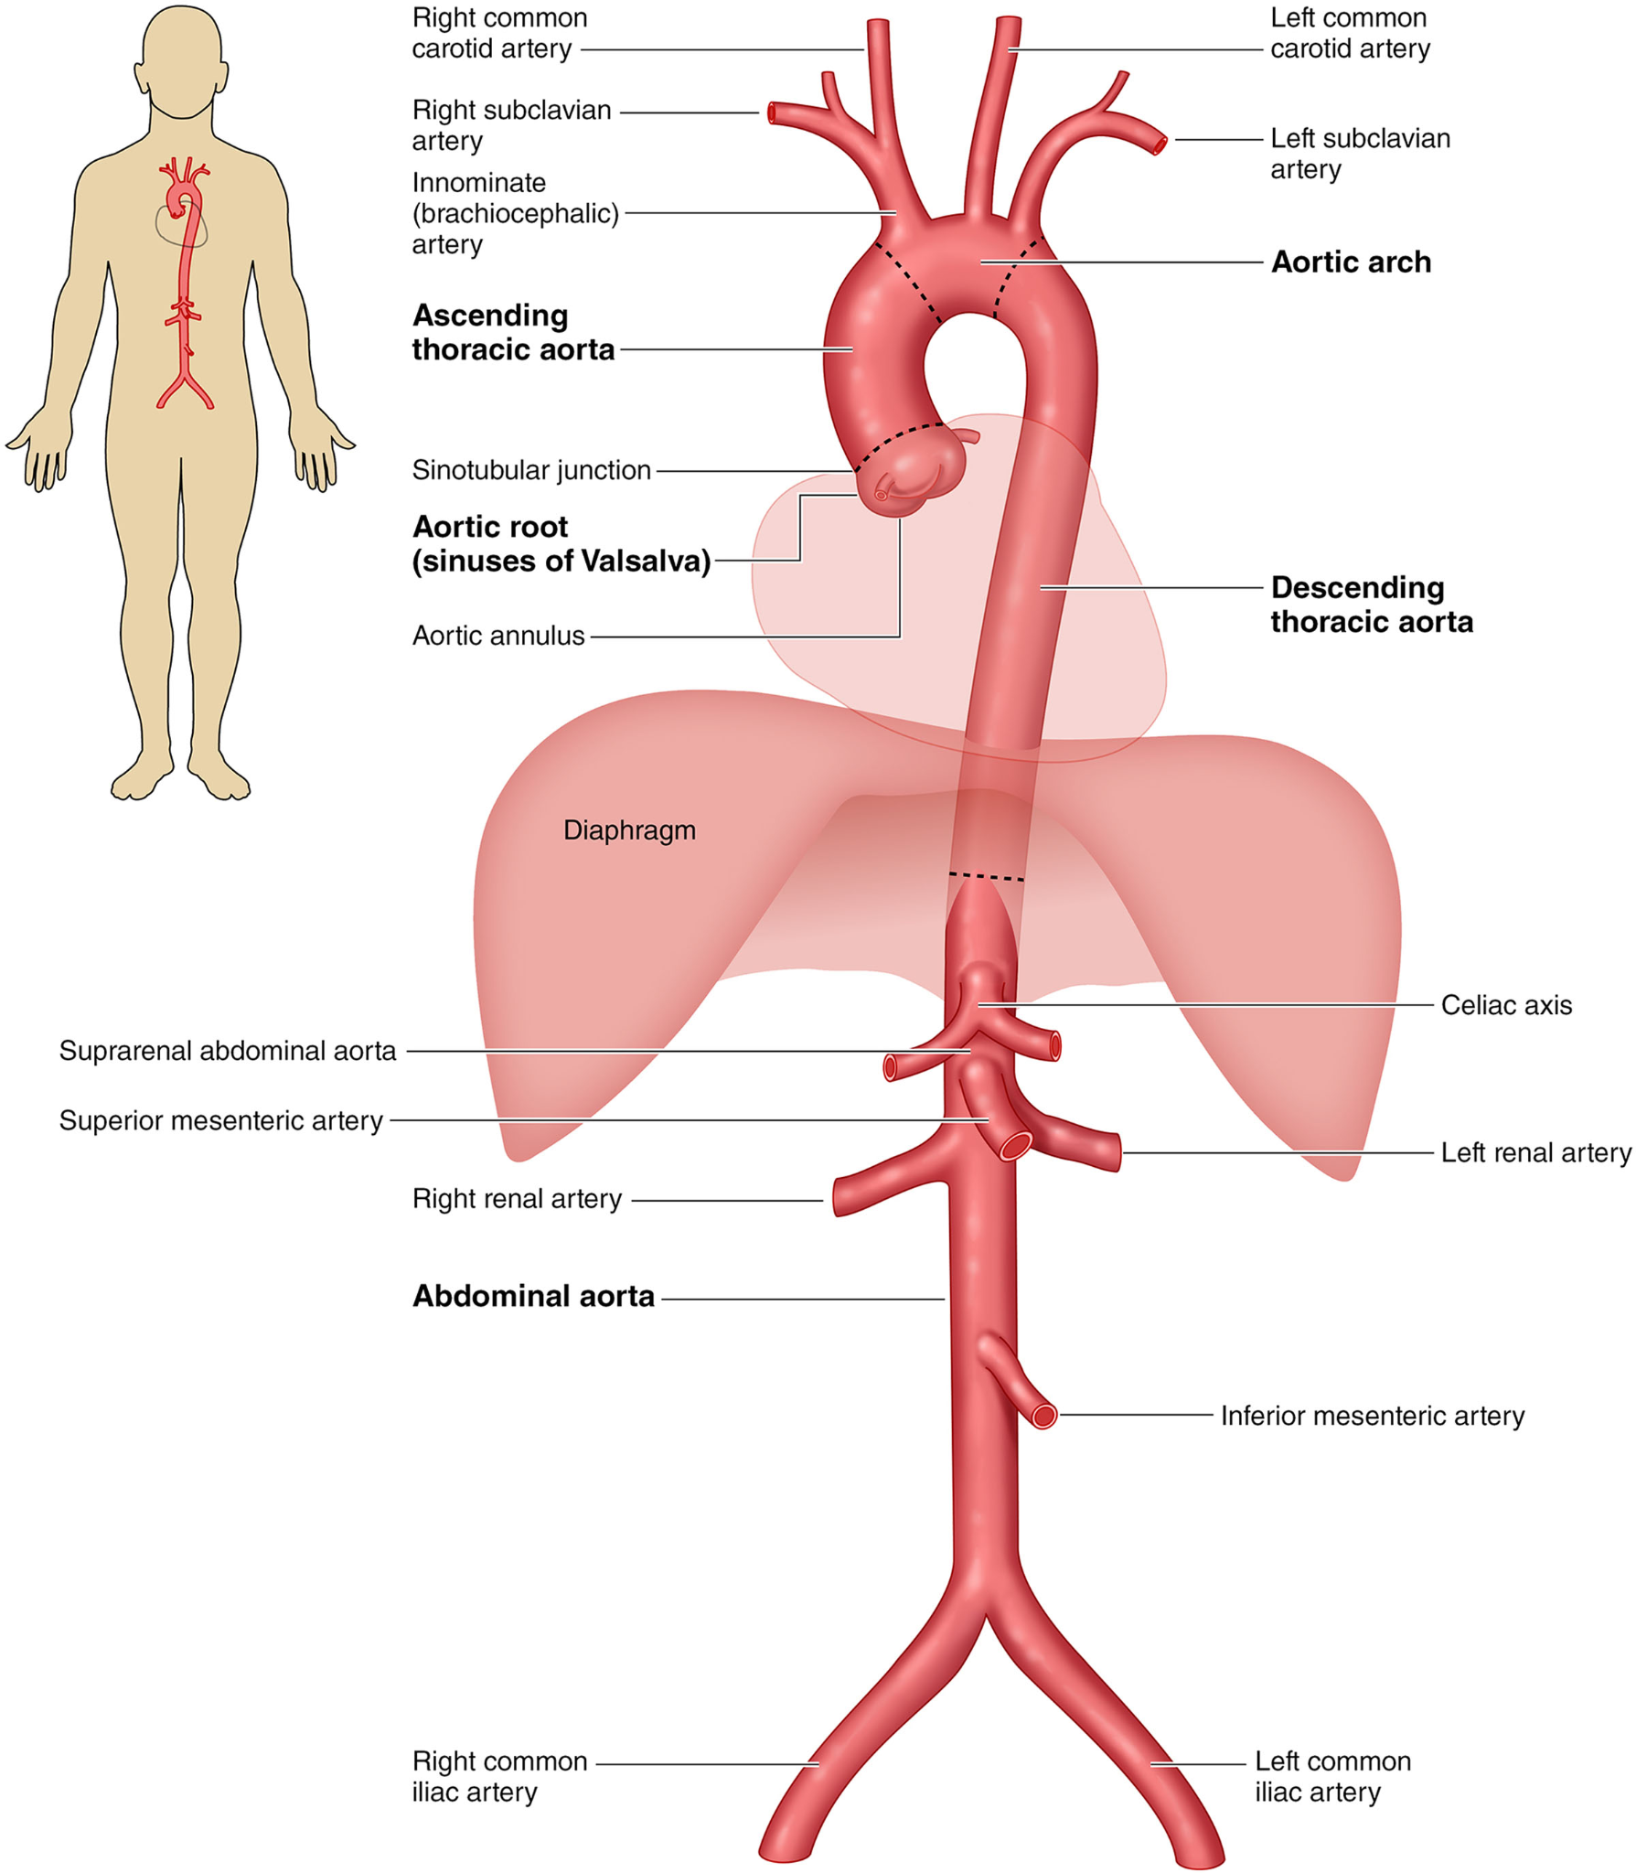
Notes:
https://doi.org/10.1161/CIR.0000000000001106

Slide 3
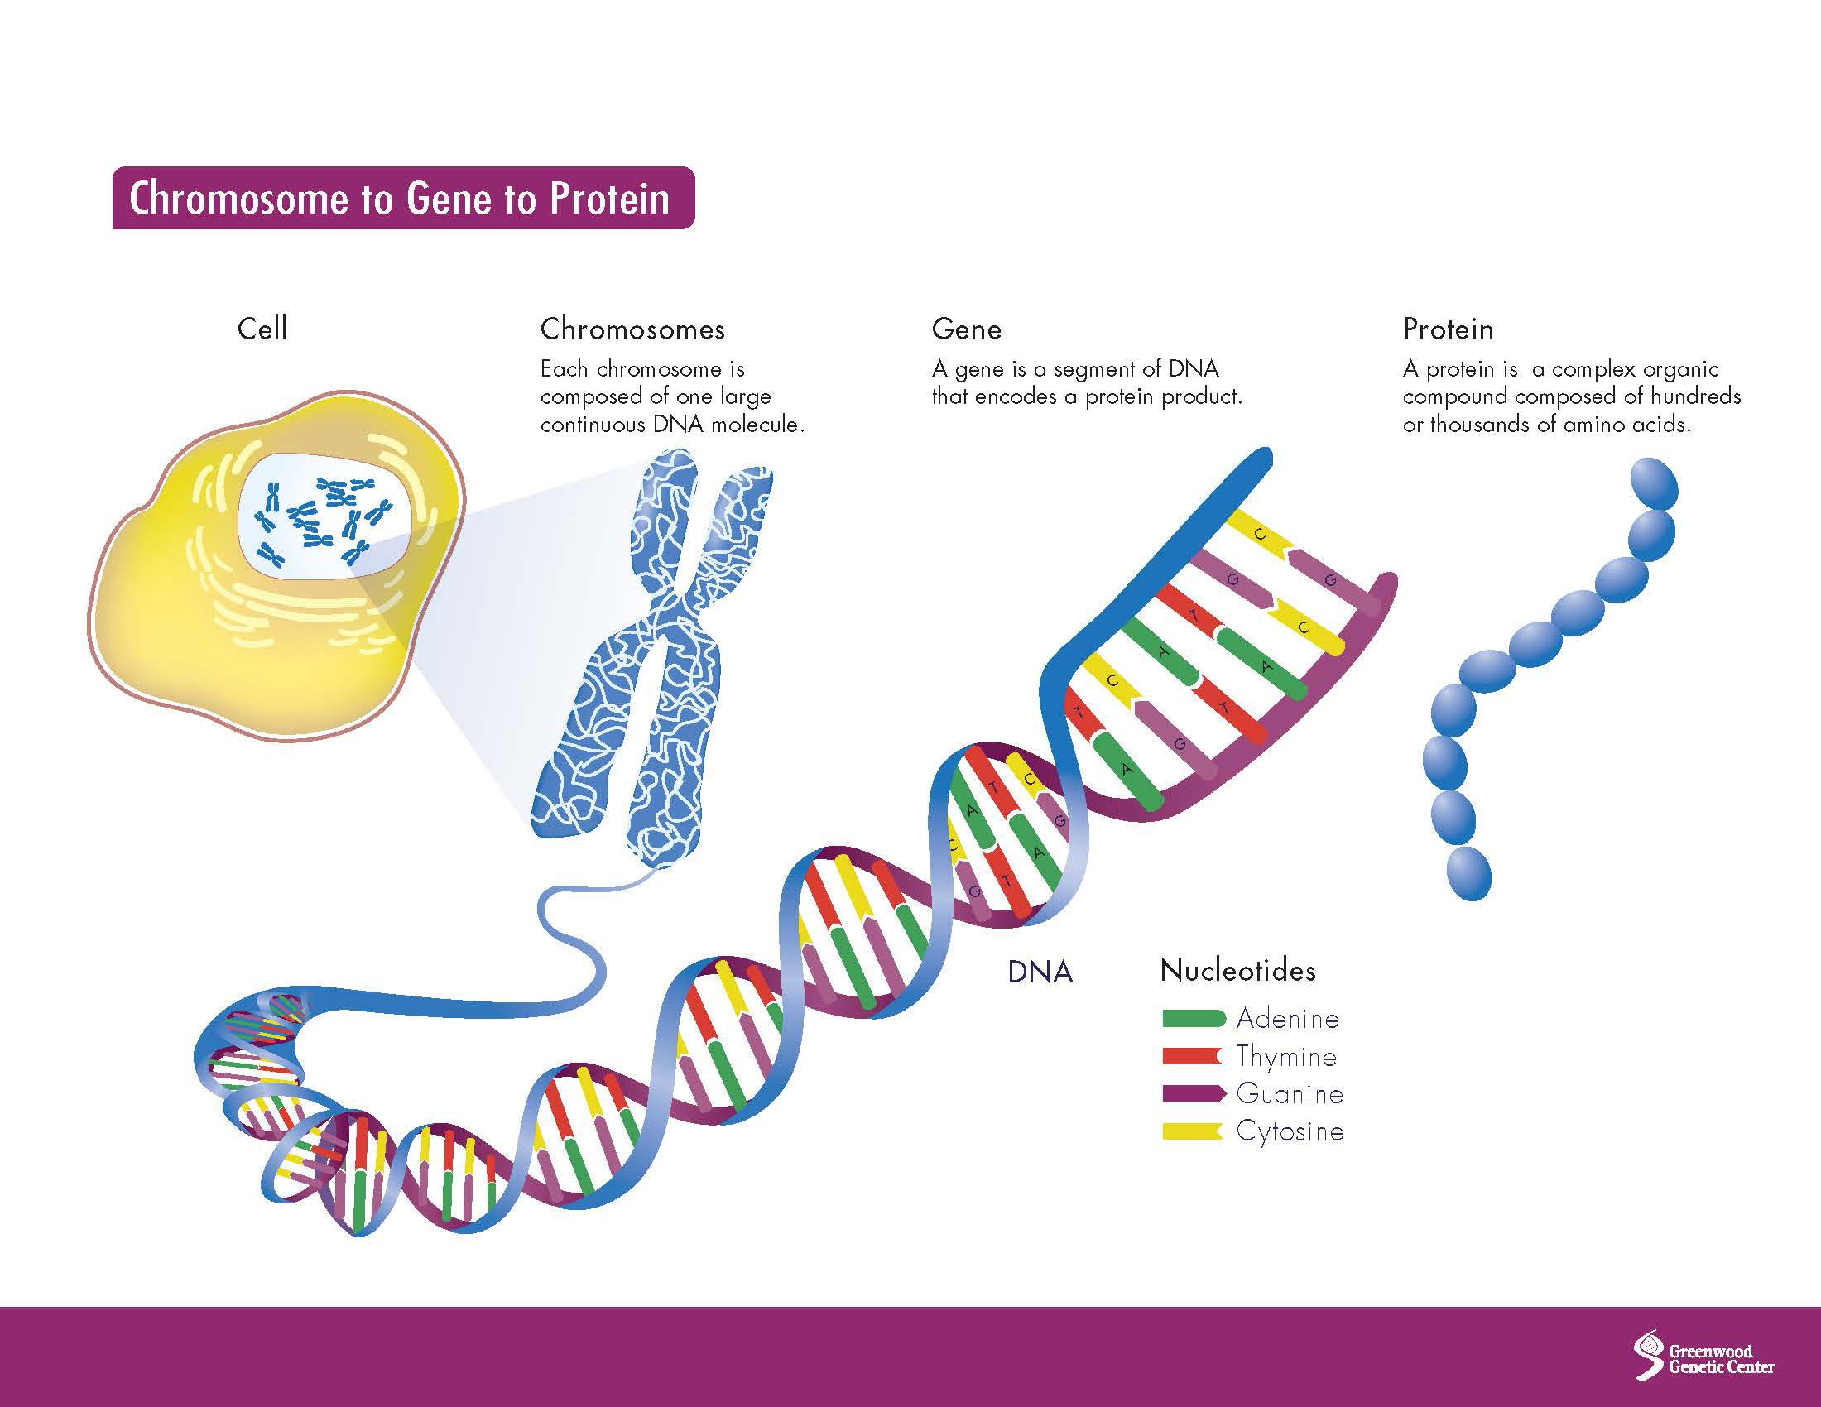

Slide 4
Post-Test Visual Aids

Slide 5
