Slide 1
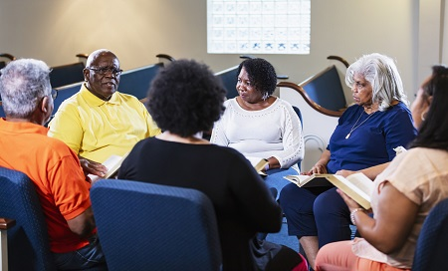



Mixed Methods Research, Community-Based Participatory Research, and Qualitative Research (MMR-CBPR-QR) Approaches Core
Core Mission
The Core addresses the needs of investigators in using three popular and interrelated research approaches (MMR, CBPR, QR) to:
Secure extramural funding
Enhance scholarship
Promote health equity
Promote community-engaged research
Develop applied knowledge and skills in these methodologies
Core Leadership
Nataliya Ivankova, PhD, MPH
<nivankov@uab.edu>
Ronit Elk, PhD, FAAHPM
<relk@uabmc.edu>
Partnership
SHP, SOM, SON
Contact
Email: mcqcore@uabmc.edu
Services
Consulting
Study conceptualization, design, and implementation
CBPR principles and procedures
Grant writing
Abstract and manuscript preparation
Data Collection, Analysis, & Presentation
Qualitative data collection protocols
Qualitative and mixed methods data analysis
Data visualization
Analytical reports
Three Research Approaches
Mixed Methods Research (MMR) –
a pragmatic research approach that meaningfully integrates qualitative stakeholder engagement methods (e.g., interviews and focus groups) with quantitative outcome-focused approaches (e.g., surveys and measurements) to gain more comprehensive solutions to complex research problems.
Community-Based Participatory Research (CBPR) – a collaborative research approach that equitably involves all partners (academia and community) in the research process and recognizes the unique strength that each brings into it.
Qualitative Research (QR) – a naturalistic research approach that aims at gaining deep understanding of the human experience and behavior through interpreting perspectives of a purposefully selected group of people collected via interviews, focus groups and naturalistic observations.
Training
Mixed Methods Research | CBPR | Qualitative Research
Mixed methods research essentials | Principles of CBPR | Qualitative research essentials
Designing a mixed methods study | Creating Community partnerships | Qualitative research designs
Integration in mixed methods research | Learning to respect equality in partnership | Principles of qualitative data collection
Approaches to mixed methods analysis | Principles of creating community advisory groups | Approaches to qualitative data analysis
Reporting a mixed methods study | Roles of community advisory groups | Data analysis with qualitative research software
Developing an IRB application for a mixed methods study | Community advisory group meetings | Reporting qualitative research
Developing a mixed methods grant proposal | Focus group principles and methods | Developing an IRB application for qualitative study
Using mixed methods in intervention research | Developing a training program for clinicians based on focus group findings
Intersecting mixed methods with CBPR and action research

