Slide 1


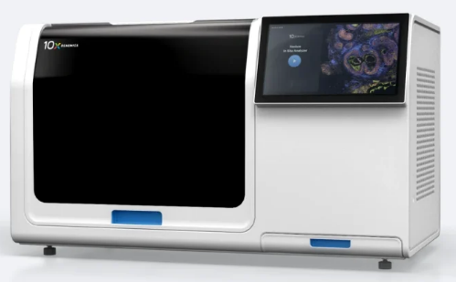
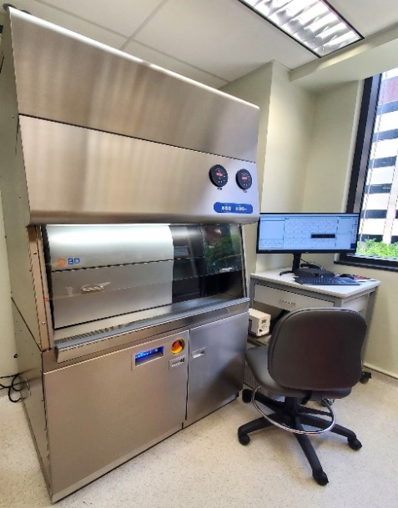
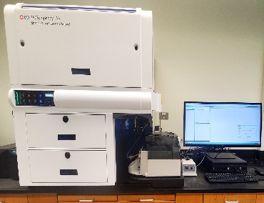
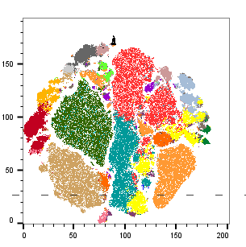
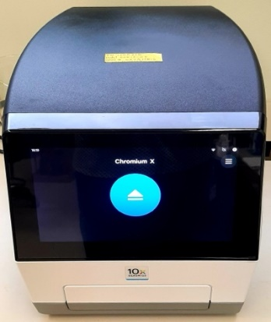
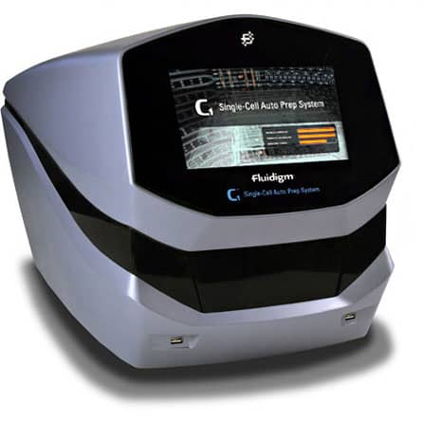
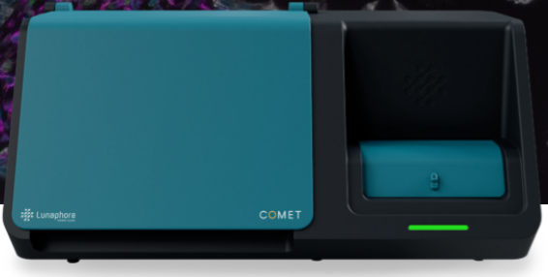
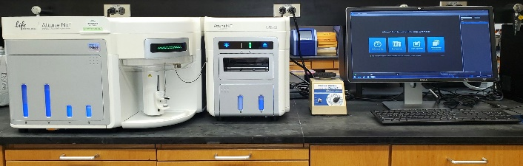



UAB Flow Cytometry and Single Cell Core Facility
Vidya Sagar Hanumanthu, Shanrun Liu, Harish Chandra Pal, Chaio-Wang Sun, Davide Botta, Madhubanti Basu, Karlee McBride, Teshia Houser, Haden Johnson, Damien Bynum, Amanda Costa, Julienne Carstens, James Kobie, and Troy Randall.
Flow Cytometry
Analyzers: BD FACSymphony A3, A5, A5 SE, Attune NxT
Amnis ImageStream MKII
Single Cell
Spatial Technologies
Lunaphore COMET
Visiopharm software
Immunophenotyping Services
Sorters: BD ARIA II, SORP, IIIu, S6, BD FACSMelody
Softwares: Flowjo and terraFlow
10x Visium
10x Xenium
10x Genomics
Single cell RNAseq
Fixed Single Cell RNAseq
Single Cell ATACseq
Single Cell Immune Profiling
CITE-Seq
Parse Biosciences
Fluidigm
BD Rhapsody
BioMark HD
UAB Institutional Research Core Program
UAB Center for AIDS Research
O’Neal Comprehensive Cancer Center at UAB
UAB Immunology Institute
Shelby 231 BBRB 569 FCSC@uabmc.edu 205-934-1362

