Slide 1


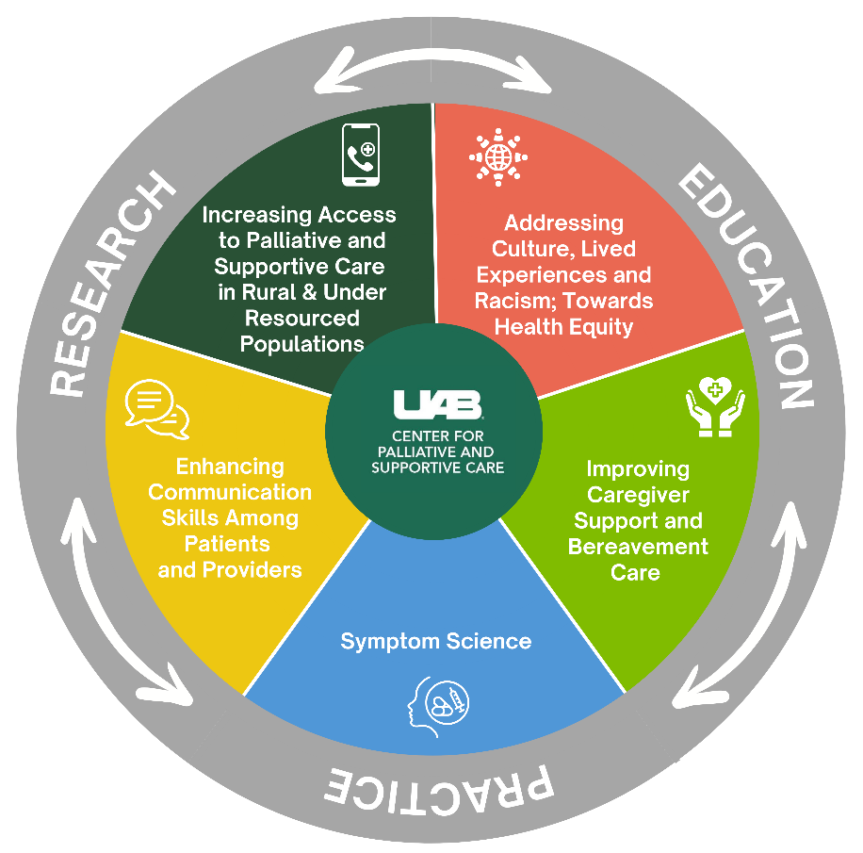



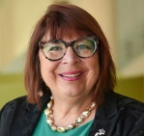
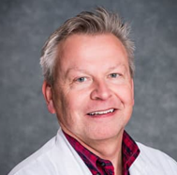






Center for Palliative and Supportive Care UWIRC
Mission
We serve patients and families experiencing serious illness by providing compassionate clinical care, demonstrating leadership in teaching health professionals and trainees, conducting collaborative research, and influencing health care delivery and public policy.
Vision
To become an international center of excellence in through personalized care, innovative approaches and sharing expert knowledge.
CPSC Research Core Themes
Center Scholars
Membership cultivates innovation & collaboration to advance palliative care research across & beyond UAB.
Senior Scientist, Scientist, Associate Scientist, and Affiliate appointments are based on shared interest in palliative & supportive care.
Center Scholars are invited to participate in CPSC activities to develop innovative and creative approaches to palliative and supportive care research.
Education & Training
We provide interprofessional training to diverse interprofessional groups to scale & spread palliative care:
Palliative Care Leadership Centers: 1 of only 9 designated US PC training institutions. We have trained >100 facilities in the US & Korea.
African American Communities Speak, Advanced Communications Training, Patient Centered Style, CBPR Immersion Training, & ELNEC Nurse Training.
Research
Seminar Series
We host monthly research meetings to provide:
Knowledge, experience, guidance, and mentorship to investigators.
Opportunities for researchers to present ideas and get input from others.
Open to ALL interested in enhancing their research skills (i.e., faculty, fellows, post-docs, graduate students, & research staff)
Center Leadership
Palliative Research
Enhancement Projects
Southeast Institute for Innovation in Palliative & Supportive Care @ UAB
We fund UAB investigators in innovative research contributing to the palliative & supportive care evidence base to serve as pilot data for future external funding. Since 2014, PREP has awarded $496,410 to 27 projects
Dr. Marie
Bakitas
Associate Director
for Research
Dr. Rodney
Tucker
Interim CPSC UWIRC Director
Dr. Emily
Johnston
Director, Pediatric Palliative Research & Education
Racheal
Nerud, MBA
Program Director
for Research
SIIPSC aspires to lead the nation in revolutionizing palliative care, through research, outreach, & education. We expand palliative and supportive care expertise & increase access for people living with serious illness in the Southeast.
Forging the Future of Palliative Care Summit takes place every two years. See you in 2026!
Interested in learning more? Visit our webpage or contact
Racheal Nerud at rg14@uab.edu.
Letters of Intent Due:
January 25th at 5:00pm
Special Call This Year:
Community Agency Partnerships

